Slide 1
A Bayesian Method for Rank Agreggation
Xuxin Liu, Jiong Du, Ke Deng, and Jun S Liu
Department of Statistics
Harvard University

Slide 2
Outline of the talk
Motivations
Methods Review
  Classics: SumRank, Fisher, InvZ
  State transition method: MC4, MCT
Bayesian model for the ranks
  power laws
  MCMC algorithm
Simulation results

Slide 3
Motivations
Goal: to combine rank lists from multiple experiments to obtain a “most reliable” list of candidates.
Examples:
  Combine ranking results from different judges
  Combine biological evidences to rank the relevance of genes to a certain disease
  Combine different genomic experiment results for a similar biological setup

Slide 4
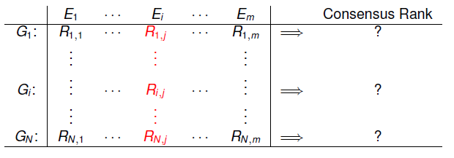
Data – the rank matrix
The ranks of N “genes” in M experiments.
Questions of interest:
  How many genes are “true” targets (e.g., truly differentially expressed, or truly involved in a certain biological function)
  Who are they?

Slide 5
Challenges
Full rank list versus partial rank list
  Sometimes we can only “reliably” rank the top k candidates (genes)
The quality of the ranking results can vary greatly from experiment (judge) to experiment (judge)
There are also “spam” experiments that give high ranks to certain candidates because of some other reasons (bribes)

Slide 6
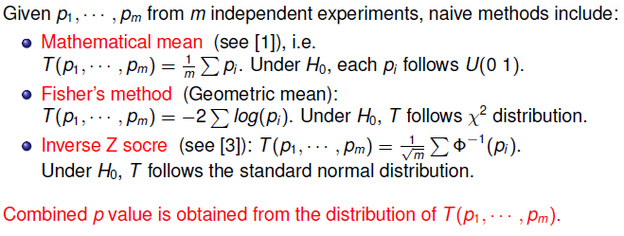
Some available methods
Related to the methods for combining multiple p-values:

Slide 7
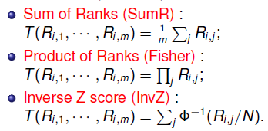
Corresponding methods for ranks
Under H₀, each candidate’s rank is uniformly distributed in {1,…,N}. Hence, the p-value for a gene ranked at the k^{th} place has a p-value k/N.
Hence the previous 3 methods correspond to

Slide 8
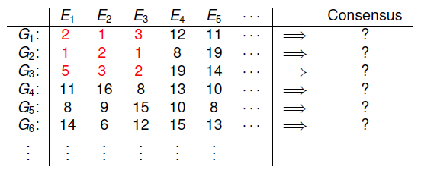
Problems with these methods
Experiments are treated equally, which is sometimes undesirable

Slide 9

Transition matrix method
(google inspired?)
Treat each gene as a node. P(i,j) is the transition probabilities from i to j.
The stationary distribution is given by
The importance of each candidate is ranked by π

Slide 10
MC4 algorithm
The method is usually applied to rank the top K candidates, so P is K×K matrix
  Let U be the list of genes that hare ranked as top K at least once in some experiment
  For each pair of genes in U, let if for a majority of experiments i is ranked above j.
  Define
  Make P ergodic by mixing:

Slide 11
Comments
The method can be viewed as a variation of the simple majority vote
As long as spam experiments do not dominate the truth, MC4 can filter them out.
Ad-hoc, no clear principles behind the method.

Slide 12
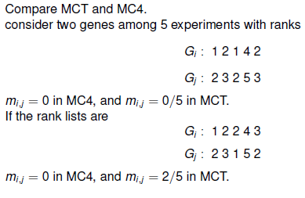
MCT algorithm
Instead of using 0, or 1 for , it defines
where is the number of times i ranked before j.

Slide 13

A Bayesian model
We introduce D as an indicator vector indicating which of the candidates are among the true targets:
  if the ith gene is one of the targets, 0 otherwise. Prior
  The joint probability:
where is the rank list from the jth experiment

Slide 14
Given D, we decompose R_{j} into 3 parts:
  , the relative ranks within the “null genes”, i.e., with
  , the relative ranks within “targets”, i.e., with
  , the relative ranks of each target among the null genes.

Slide 15
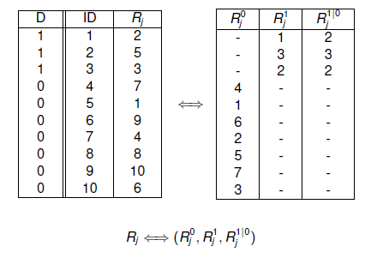
Example

Slide 16
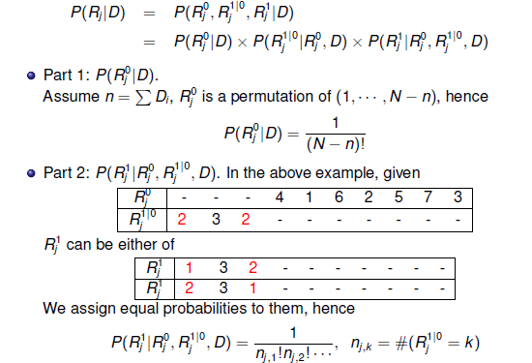
Decompose the likelihood

Slide 17
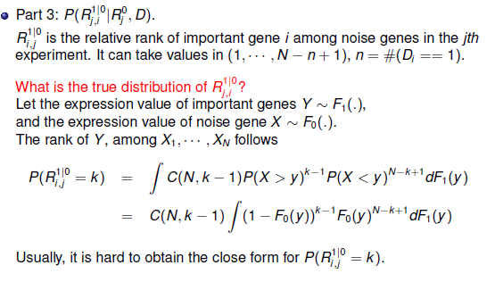

Slide 18
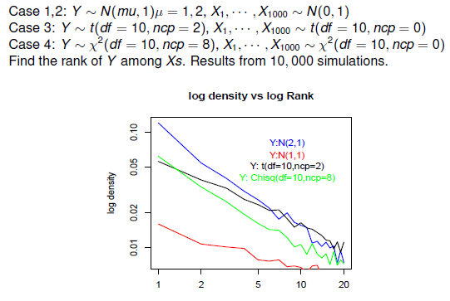
Power law?

Slide 19
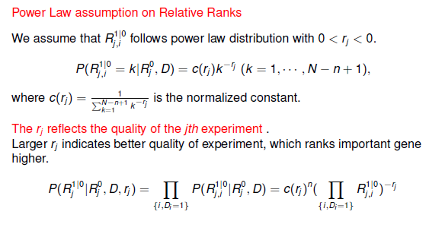

Slide 20
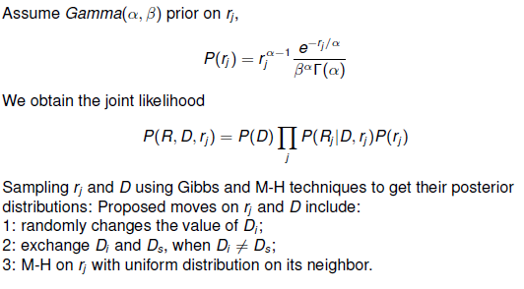
An MCMC algorithm

Slide 21
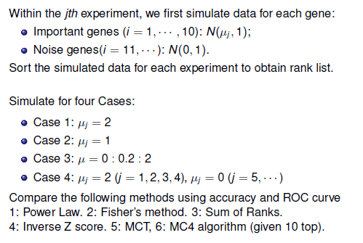
Simulation Study 1

Slide 22
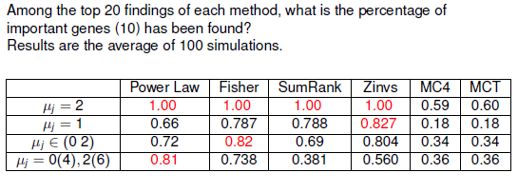
True positives in top 20:

Slide 23
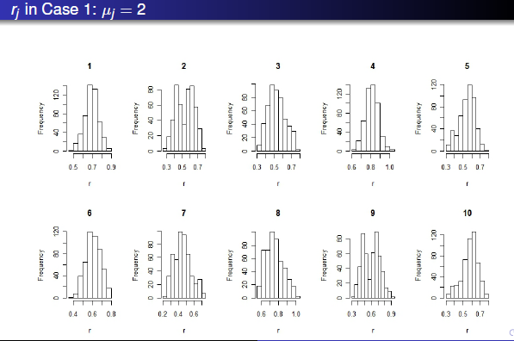
Inferred qualities of the experiments

Slide 24
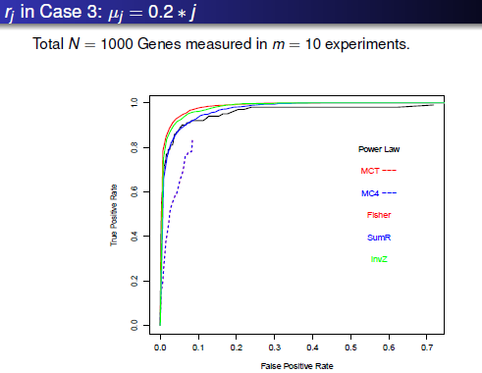

Slide 25
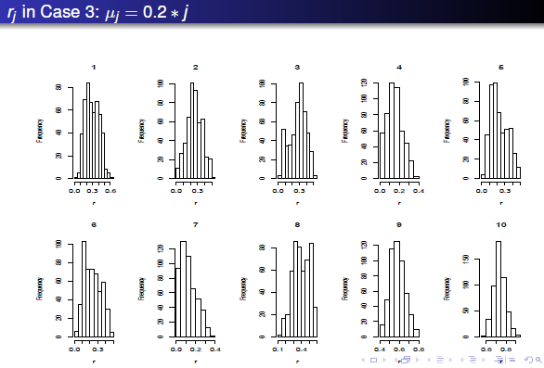

Slide 26
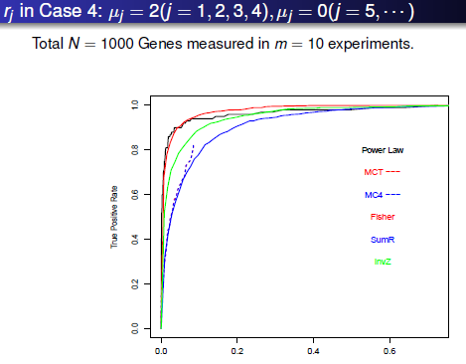

Slide 27
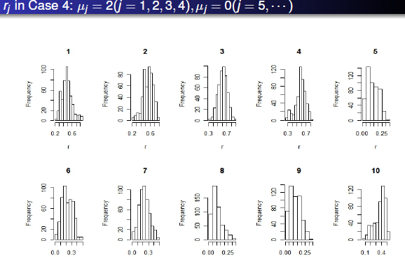

Slide 28
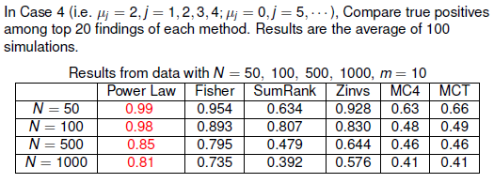
Simulation 2: power of the spam filtering experiments

Slide 29
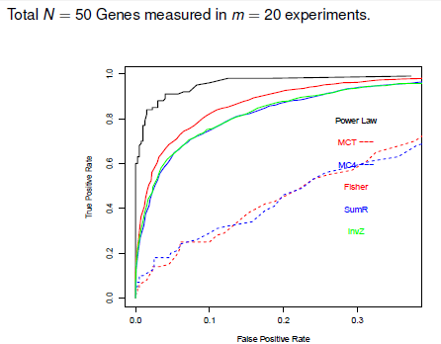

Slide 30
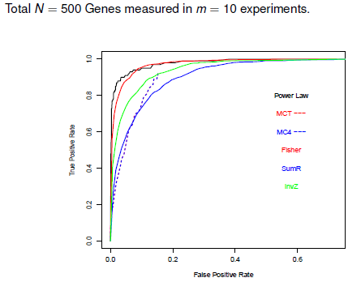

Slide 31
Summary
The Bayesian method is robust, and performs especially well when the data is noisy and experiments have varying qualities
The Fisher’s works quite well in most cases, seems rather robust to noisy experiments
The MC-based methods worked surprisingly badly, with no exception

